Slide 2
ORIGINAL PROPOSAL FOR “AMERICAN CHEESE WEEK” PRESENTED TO ACS BOARD AT FALL 2010
BOARD MEETING IN MONTRÉAL

Slide 3
AMERICAN CHEESE MONTH COMMITTEE
Patrick Bleck, DPI Specialty Foods
Jeanne Carpenter, Wisconsin Cheese Originals
Mark Goldman, Formaticum
Sara Hill, Wisconsin Milk Marketing Board
Christine Hyatt, Cheese Chick Productions
Becca Orozco, American Cheese Society

Slide 4
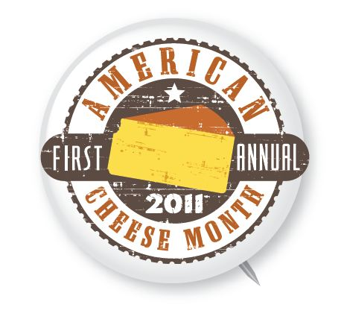

Slide 5
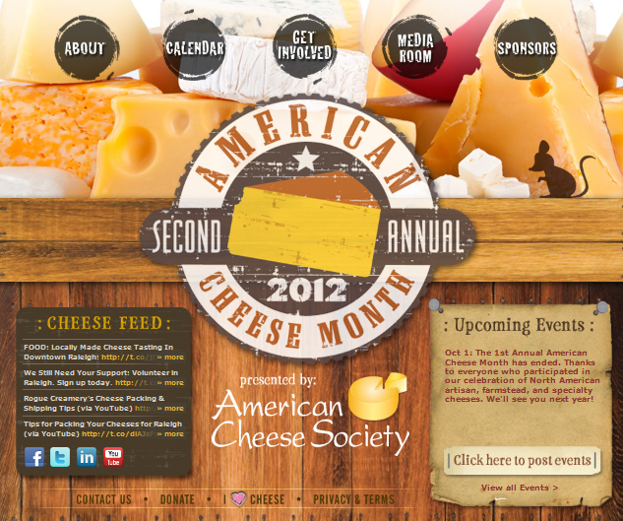
WWW.AMERICANCHEESEMONTH.ORG

Slide 6
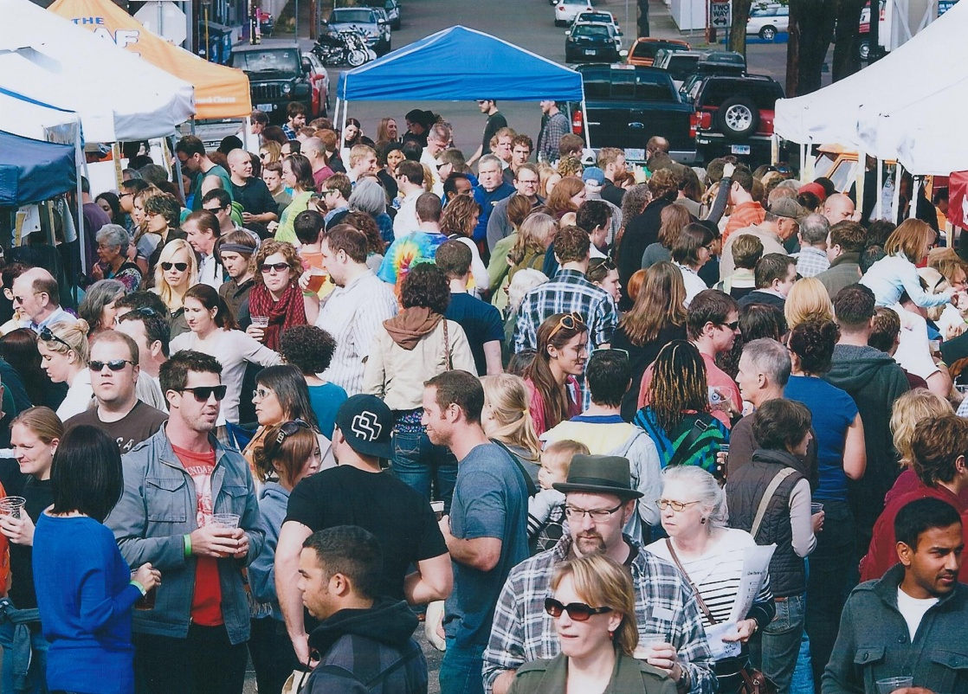
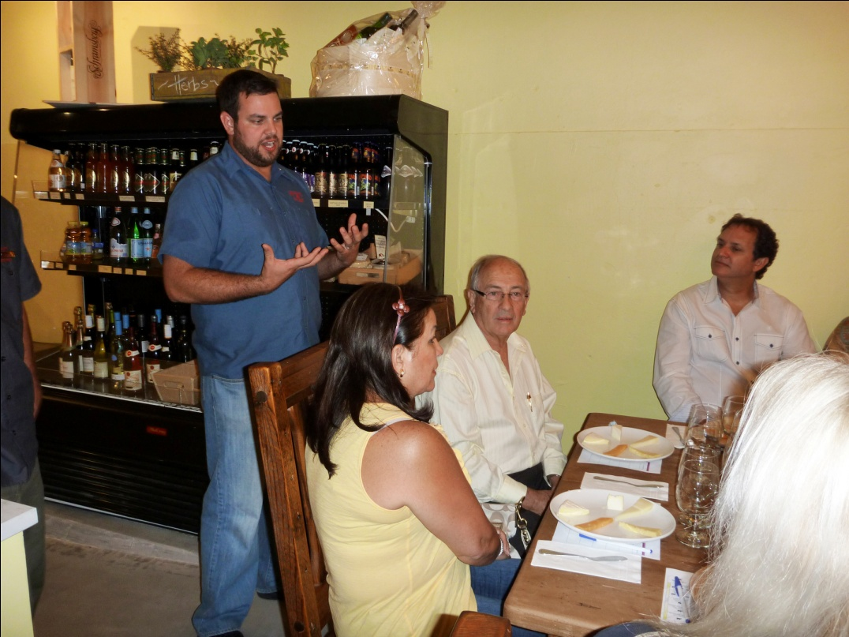
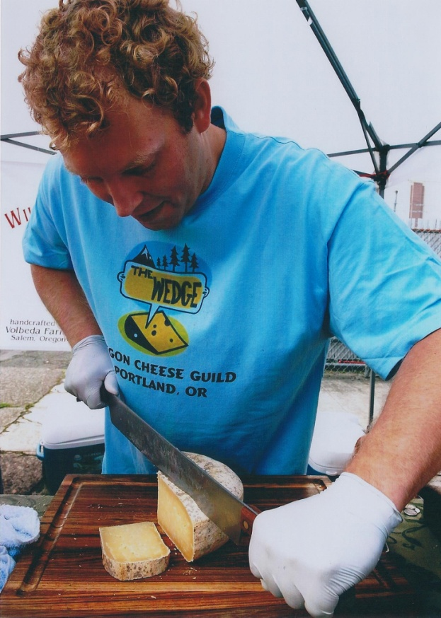
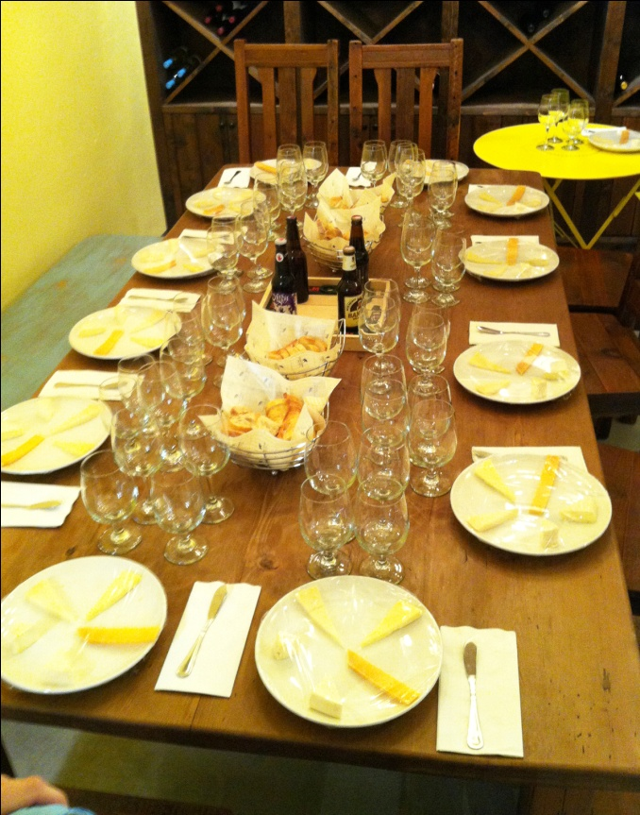
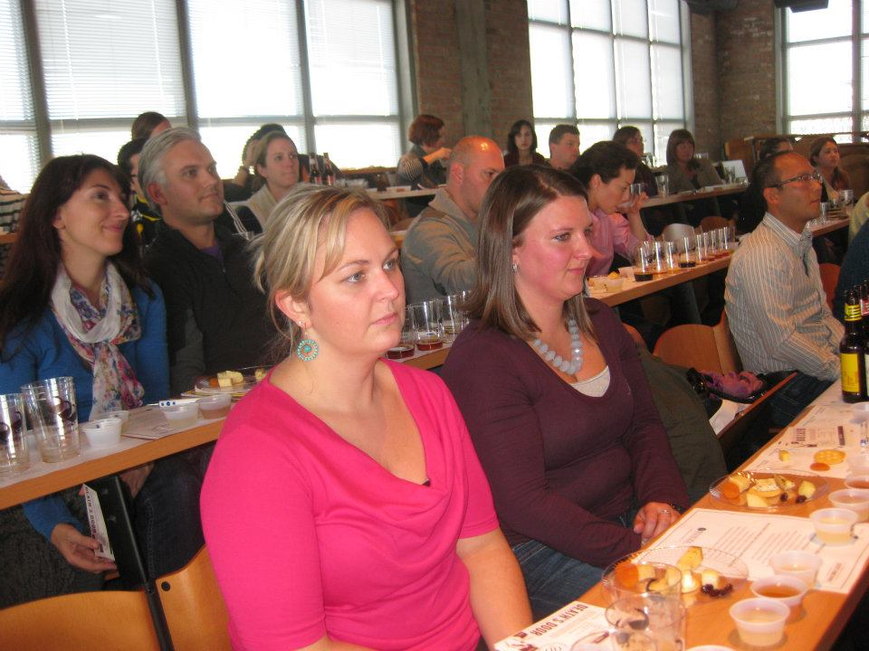
Beer & Cheese Pairing Class
Cheese Culture, FL
(also photo below)
The Wedge: Portland Celebrates Cheese Festival, OR
Wisconsin Cheese & Beverage Pairing Experience
Kendall College, IL

Slide 7
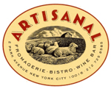
AMERICAN CHEESE MONTH PASSPORT

Slide 8
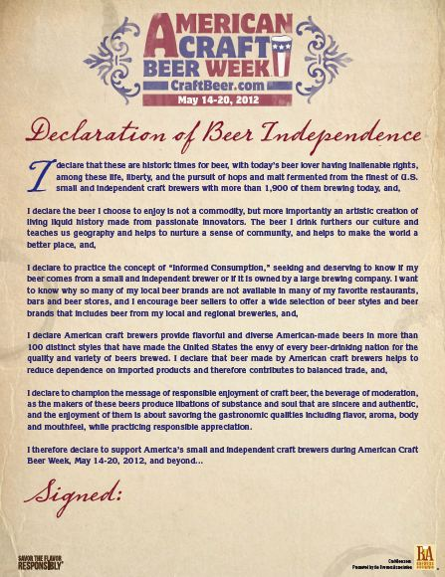
AMERICAN CRAFT BEER WEEK
2006: 124 breweries hosted events.
House Resolution 753 was passed
by the U.S. Congress.
2007: 150 breweries hosted events.
2008: 168 breweries hosted events.
Declaration of Beer Independence
was introduced.

Slide 9
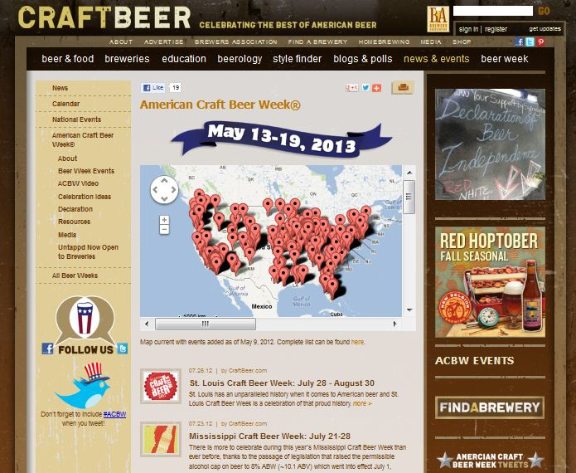
AMERICAN CRAFT BEER WEEK
2009: 212 breweries hosted more than
500 events.
2010: 341 breweries hosted 621 events
in 45 states. House Resolution 1297
was passed by the U.S. Congress.
2011: 1,521 events posted to the official
ACBW calendar in 50 states.
2012: 1,368 events posted to the official
ACBW calendar in 50 states.

Slide 10
CRAFT BREWERS ASSOCIATION
TEMPLATES & SUPPORT INCLUDING:
Promotional Materials – banner/posters at http://www.craftbeer.com/pages/news-and-events/american-craft-beer-week/resources
Declaration of Beer Independence – PDF can be downloaded at http://www.craftbeer.com/pages/news-and-events/american-craft-beer-week/declaration
Website/Event Calendar (screenshot)
Media Outreach & Promotion

Slide 11
AMERICAN CHEESE MONTH

Slide 12
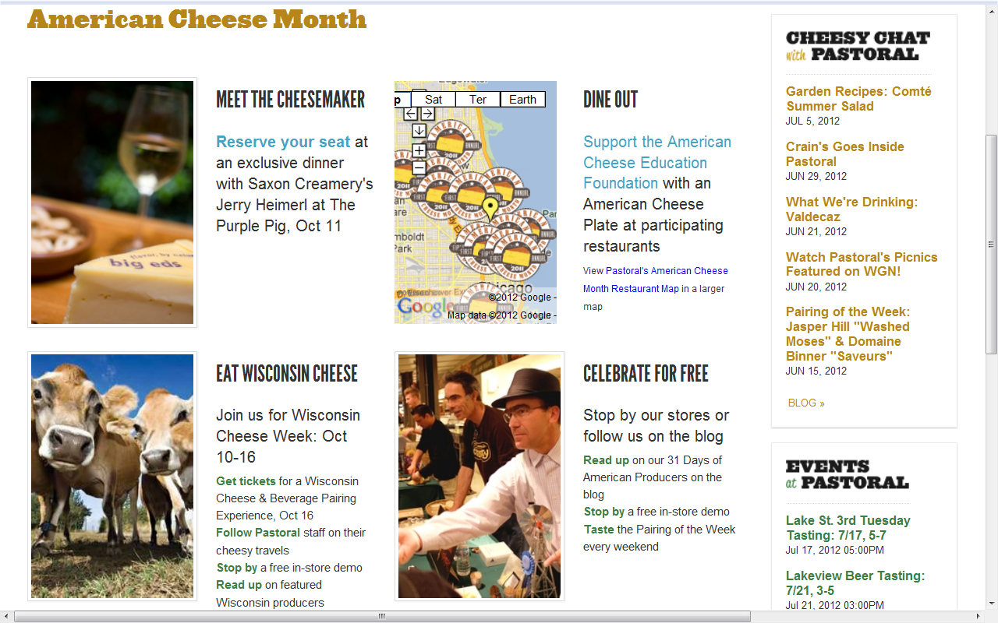

Slide 13
CHEESEMAKER DINNER
FEATURING SAXON CREAMERY, PASTORAL AND THE PURPLE PIG
$95/person
$5/person donated to ACE Foundatoin
Charred Broccoli with Anchovy-Herb Vinaigrette, Breadcrumbs,
‘Saxony’ (Alpine Style)
Salad of Frisee, Crispy Jowl, Sunchokes, Poached Egg, Honey-Cider Vinaigrette,
‘Big Ed’s’ (Gouda Style)
Bone-In Beef Tenderloin with Fried Brussel Sprouts, Black Trumpet Mushrooms,
‘Greenfields’ Fonduta (Washed Rind)
Grilled Cheese with Spiced Apple Butter, Almonds, Charred Grapes,
‘Pastures’ (cheddar)

Slide 14
DINE OUT AND SUPPORT THE ACE FOUNDATION

Slide 15
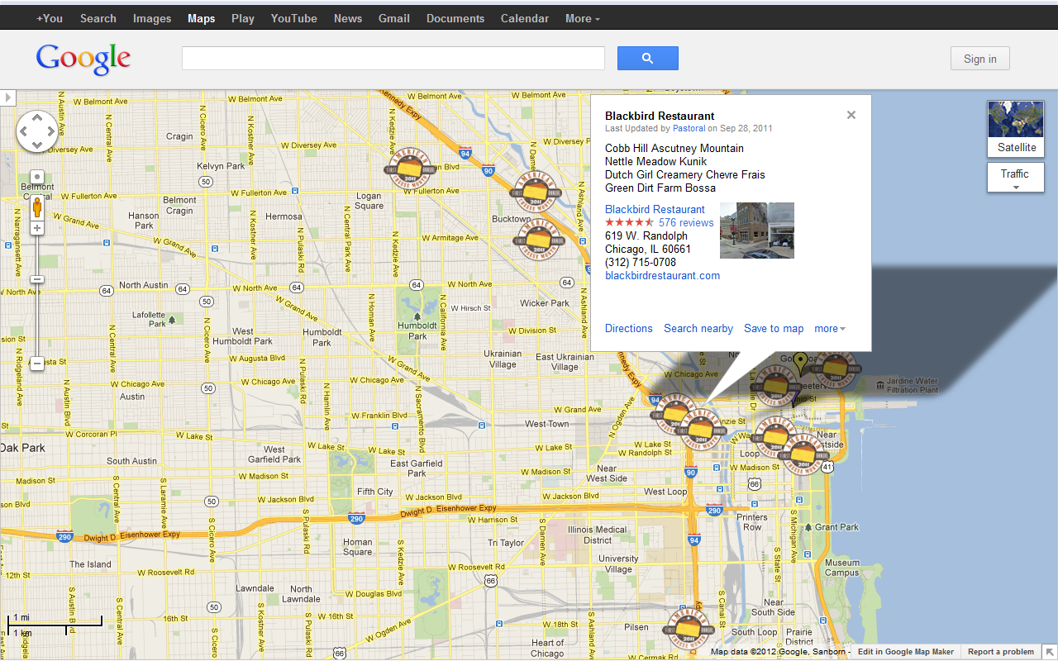

Slide 16
WISCONSIN CHEESE WEEK
WMMB Fundraiser
Pastoral Road Trips to Wisconsin
40 Pastoralites visited Uplands Cheese, Bleu Mont Dairy, Roelli, Edelweiss Creamery, and Hook’s.

Slide 17
CELEBRATE FOR FREE!
PRESS FEATURES PASTORAL
AND AMERICAN CHEESE MONTH
In store tastings for the duration of October, with Wisconsin producers during Wisconsin Cheese Week
Weekly cheese and wine pairings featuring American cheeses
31 Days of American Artisans blog posts, featuring one producer highlight each day of October

Slide 18
SOUTHERN ARTISAN
CHEESE FESTIVAL

Slide 19
SOUTHERN ARTISAN CHEESE FESTIVAL
NASHVILLE, TENNESSEE
Inaugural event in 2011, spurred by the creation of American Cheese Month and inspired by cheese festivals in other parts of the country
55+ cheesemakers in the Southeast and growing!

Slide 20
2011 EVENT OVERVIEW
14 cheesemakers attended, 3 others sent cheese to sample
25 artisan food producers
10 craft brewers and assortment of wines
Sold out crowd of 750 people
Cheesemakers and food artisans sampled and sold their goods
Ticketed event (2 levels, one with beer and wine, one without)
Secured several sponsors to help cover expenses
Portion of the proceeds went to two local food charities

Slide 21
2011 – AWESOME STUFF
Sold out!
Five southern states (TN, GA, KY, NC, AL, VA) represented
No fee for cheesemakers and food artisans to participate
Most cheesemakers sold everything they brought ($5 voucher)
Festival was able to cover cost of a hotel room for all vendors
Attendees were very engaged and enthusiastic
Financially lean operation – lots of volunteers made it happen
Received some great publicity

Slide 22
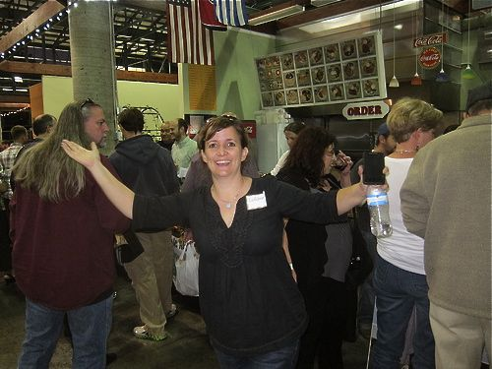
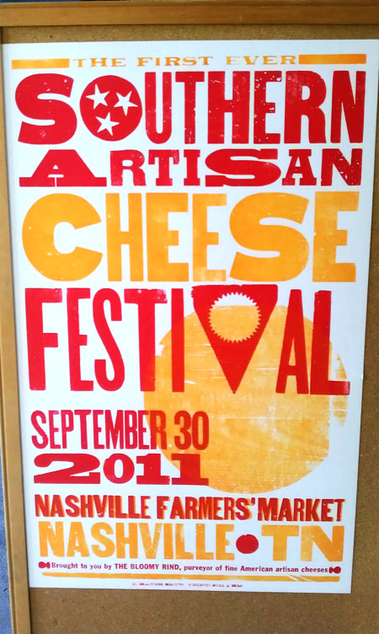
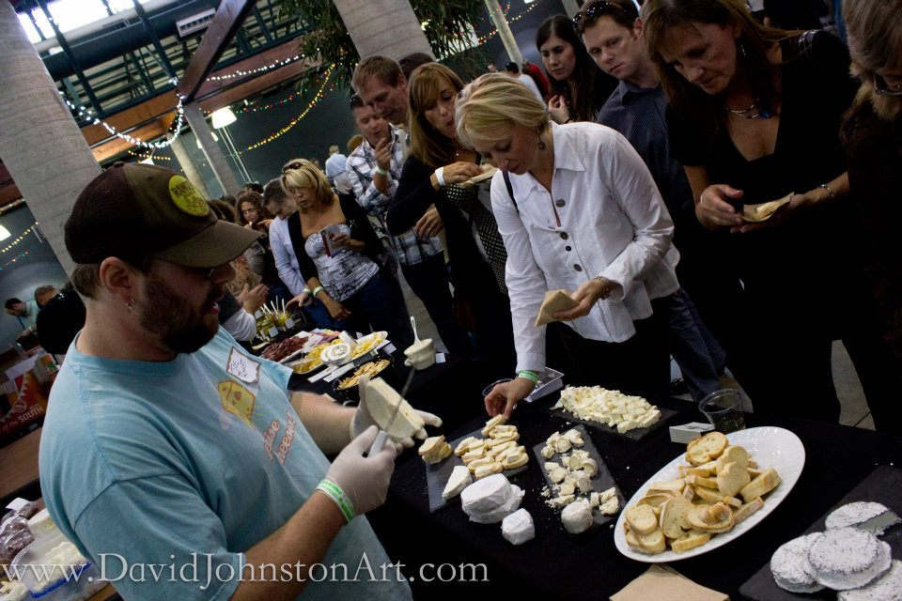

Slide 23
2011 – LESSONS LEARNED
About 50% tickets sold last minute, so tough to plan for crowd
Need more than 2 people to staff booths
Weird crowd flow thing – one ginormous line formed so slowed
everyone when one person stopped to chat
Ticket scanners at entrance gate malfunctioned
Venue space was divided into two areas (indoors and out)
Late start (May/June ’11) to planning
Not much swag other than Hatch show print+

Slide 24
NEW FOR 2012
Started planning in January
Same venue but different (larger) area
Researching best ticketing option
Exploring VIP level ticket option
More educational/tasting sessions planned
New logo and more swag
Brief period right before Fest begins for chefs
“Makers and Mongers” cheese dinner the night before
Special guest! – Gordon Edgar

Slide 25
AMERICAN CHEESE MONTH
RESOURCES FROM ACS

Slide 26
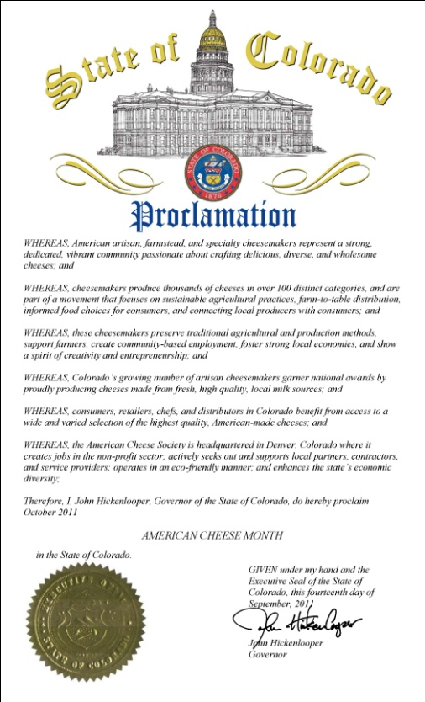
WWW.AMERICANCHEESEMONTH.ORG
Event calendar: You post, ACS will promote in
CheeseBytes, on Facebook and Twitter
Official Proclamation: Download a template
to share with your local or state government
Downloadable pairing tips and suggestions
Pins and other merchandise for your events
Winner stickers for cheese packaging and
retail displays available for sale
(Screenshot of event calendar here)

Slide 27
AMERICAN CHEESE MONTH
PASSPORT PROGRAM
“31 DAYS, 31 CHEESES”
Introducing consumers to American cheeses, and making
American cheeses more accessible
Connecting consumers and producers
In 2011: 100 events in 50 different towns/cities
Fundraiser for the American Cheese Education Foundation

Slide 28
AMERICAN CHEESE MONTH
PASSPORT PROGRAM: 2012
Passports valid at all participating retailers/shops
20-40% discount on an American cheese each day
Passports sold in-store for $10 each: No fee to participate
ACS provides passport templates, in-store signage, vendor letters
Passport sales benefit American Cheese Education Foundation
(Screenshot of event calendar here)

